Slide 1
Color Prompt
Create a color palette for a project status report to the NSF about agriculture policy.
GDPC | Activity

Slide 2
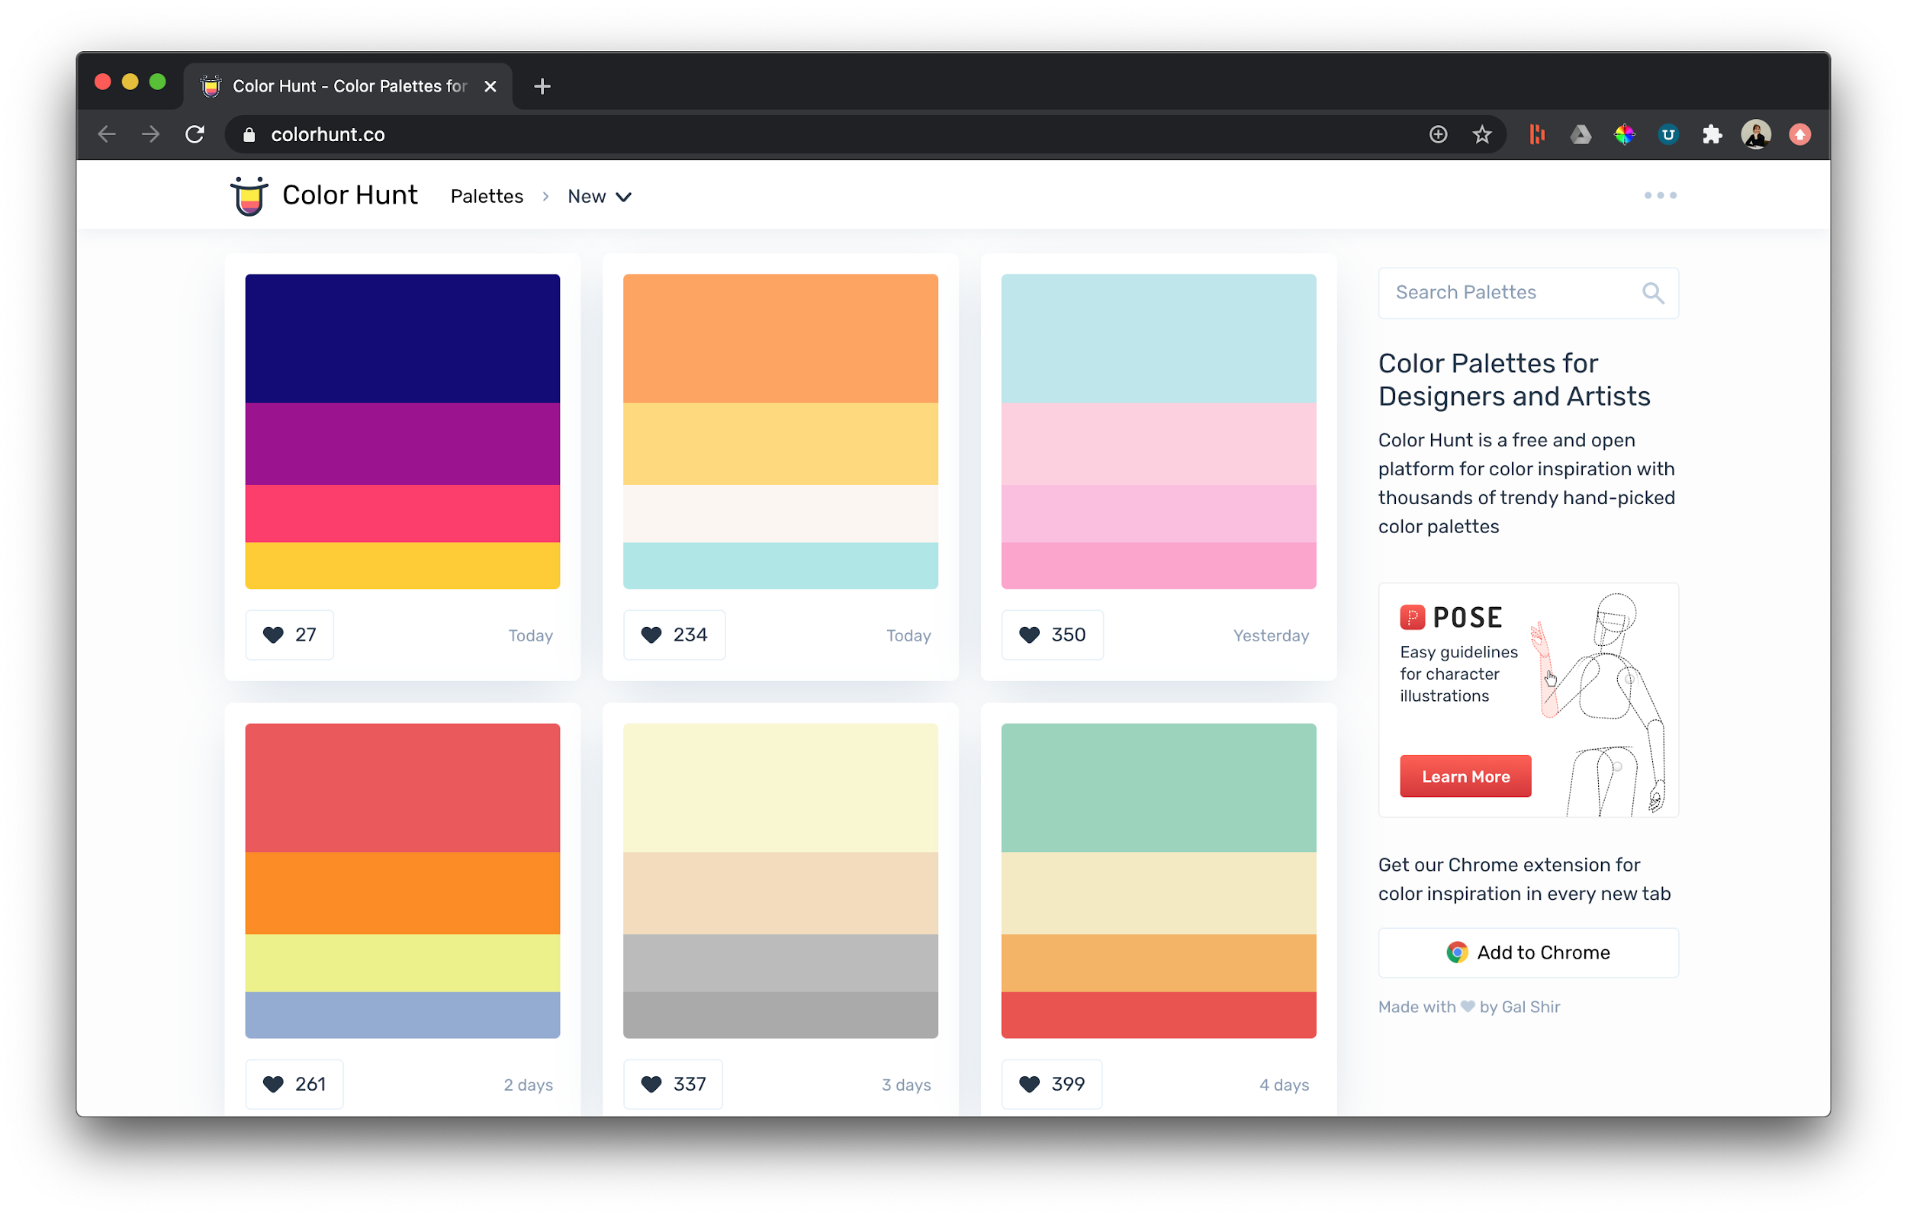
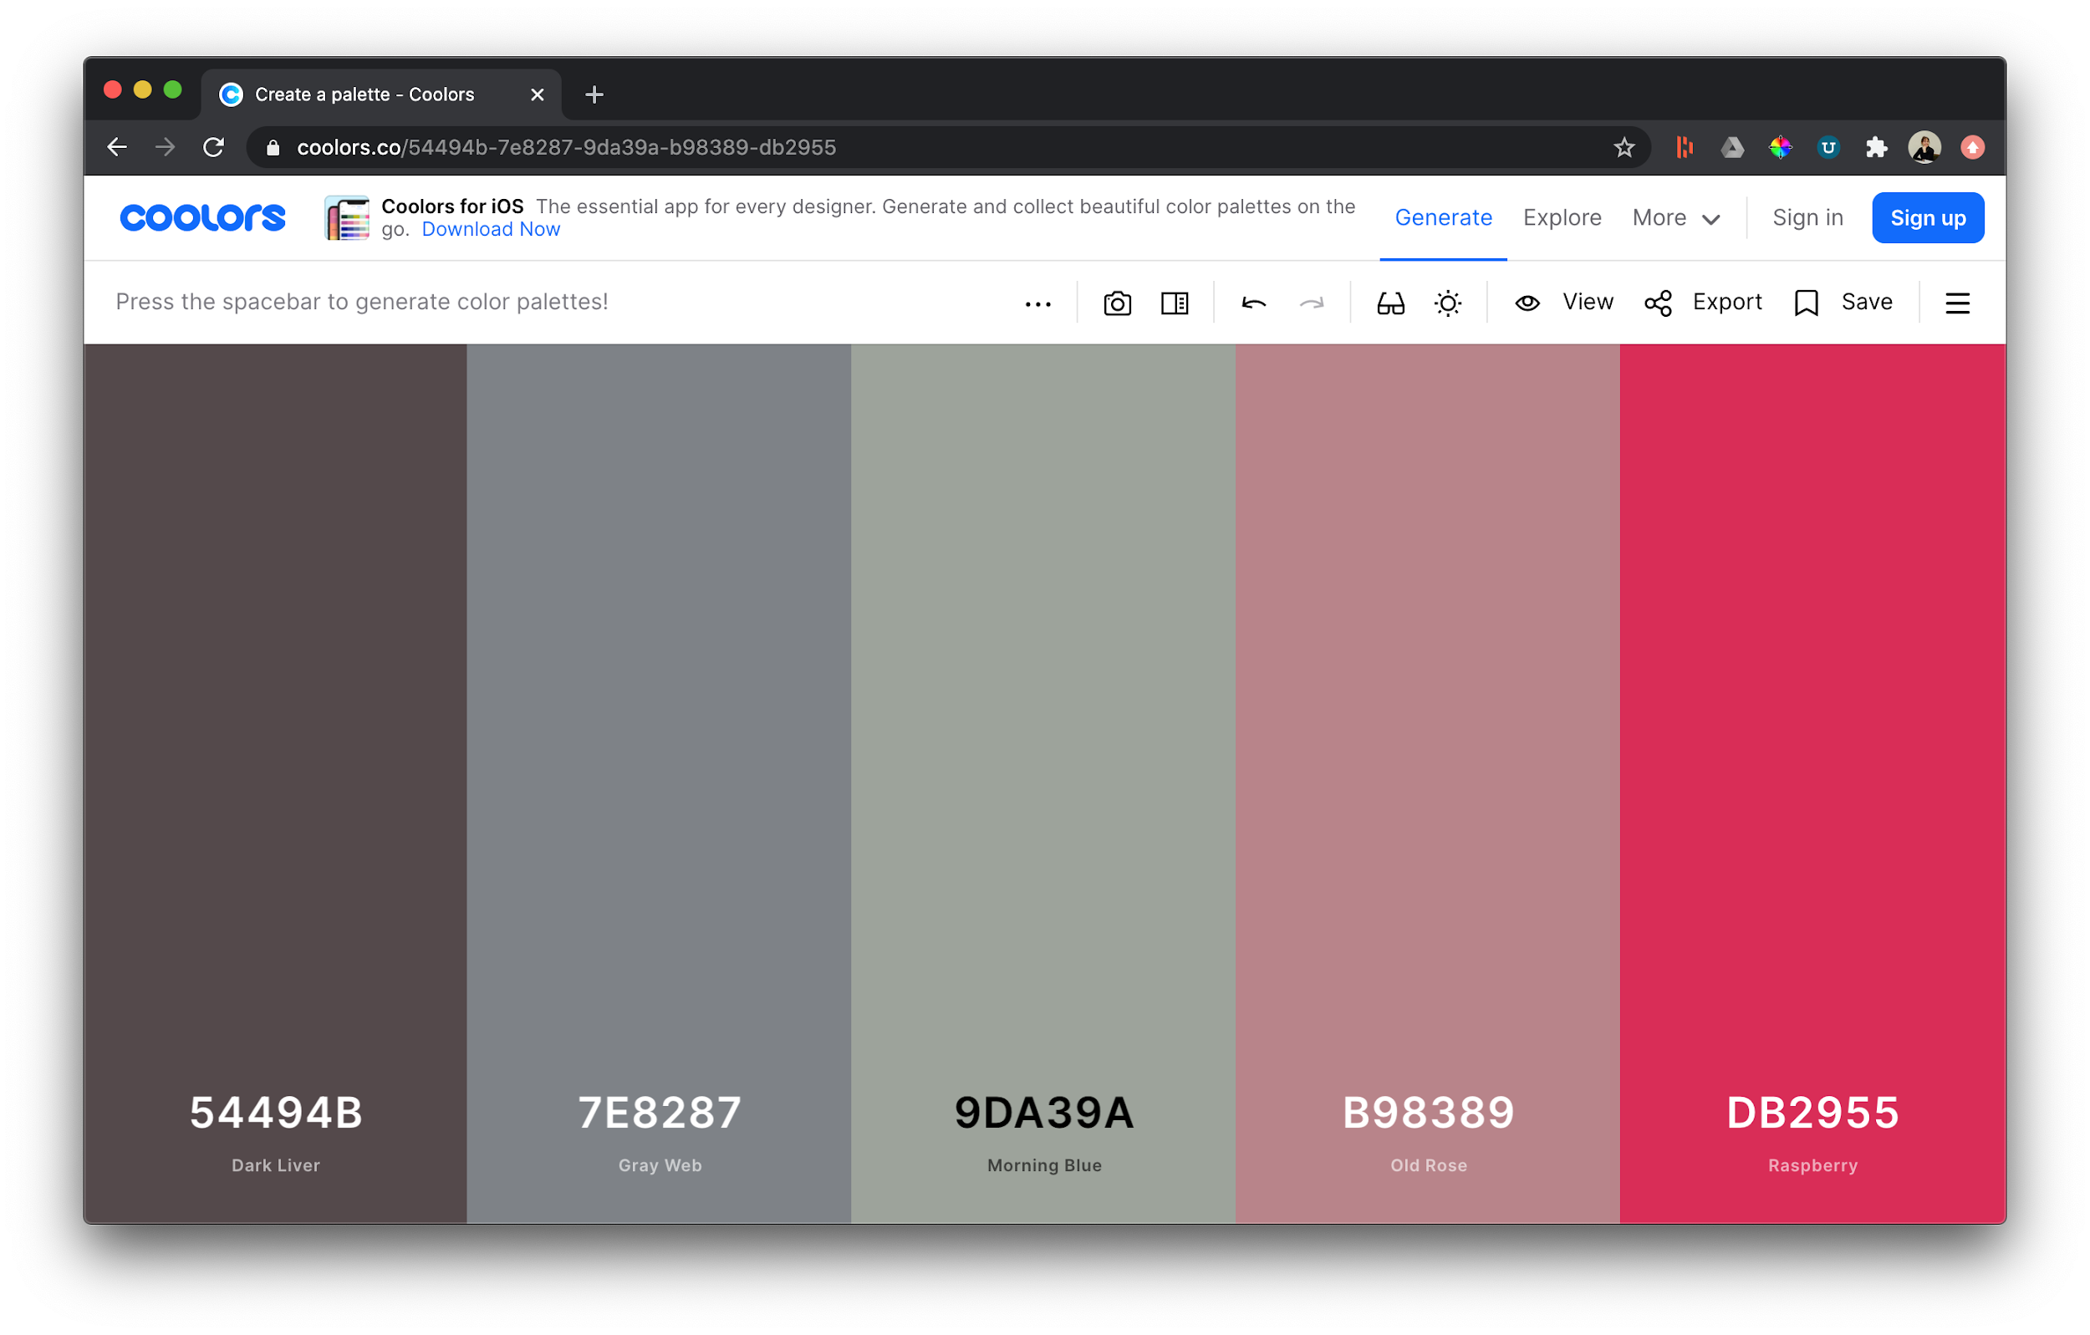
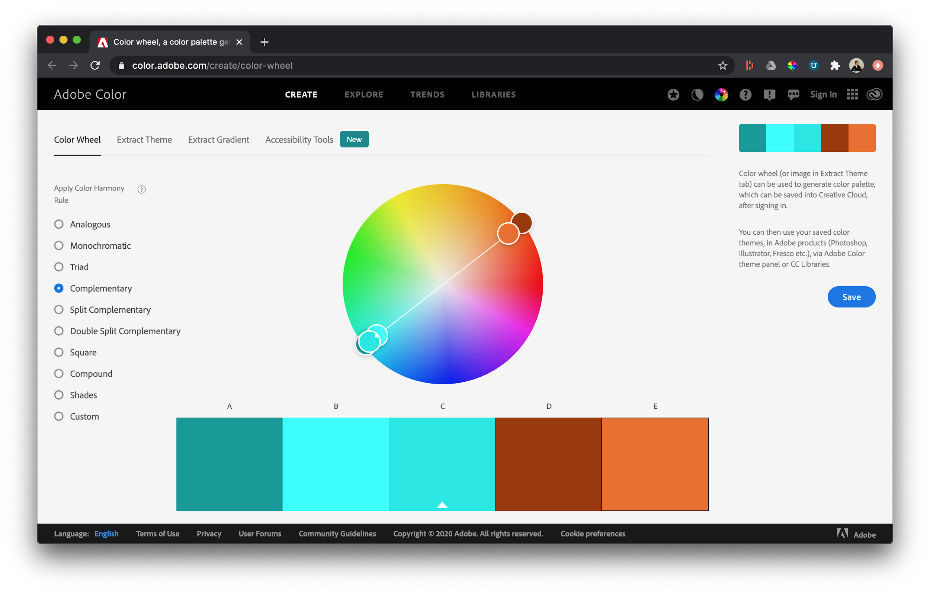
Color Palette Tools
Open up all three and give them a spin.
Find five colors that represent agricultural policy well.
Colorhunt
Coolors
Adobe
Color Wheel
GDPC | Activity

Slide 3

Insert your agriculture color palette here.
You can take a screenshot or try out the palette exporting feature available from some of the tools.
GDPC | Activity

Slide 4
Nice work!
Now download the example solutions from the activity section.
GDPC | Activity

