Slide 1
Composition Prompt
Improve the composition using the text and image provided. You may also practice your typography and color skills.
GDPC | Activity

Slide 2
Composition Instructions
Create your composition right on the next slide by moving elements around, changing the typography, and even adding color.
You can also make a copy of the slide and try to create a few different versions for different types of audiences.
GDPC | Activity

Slide 3
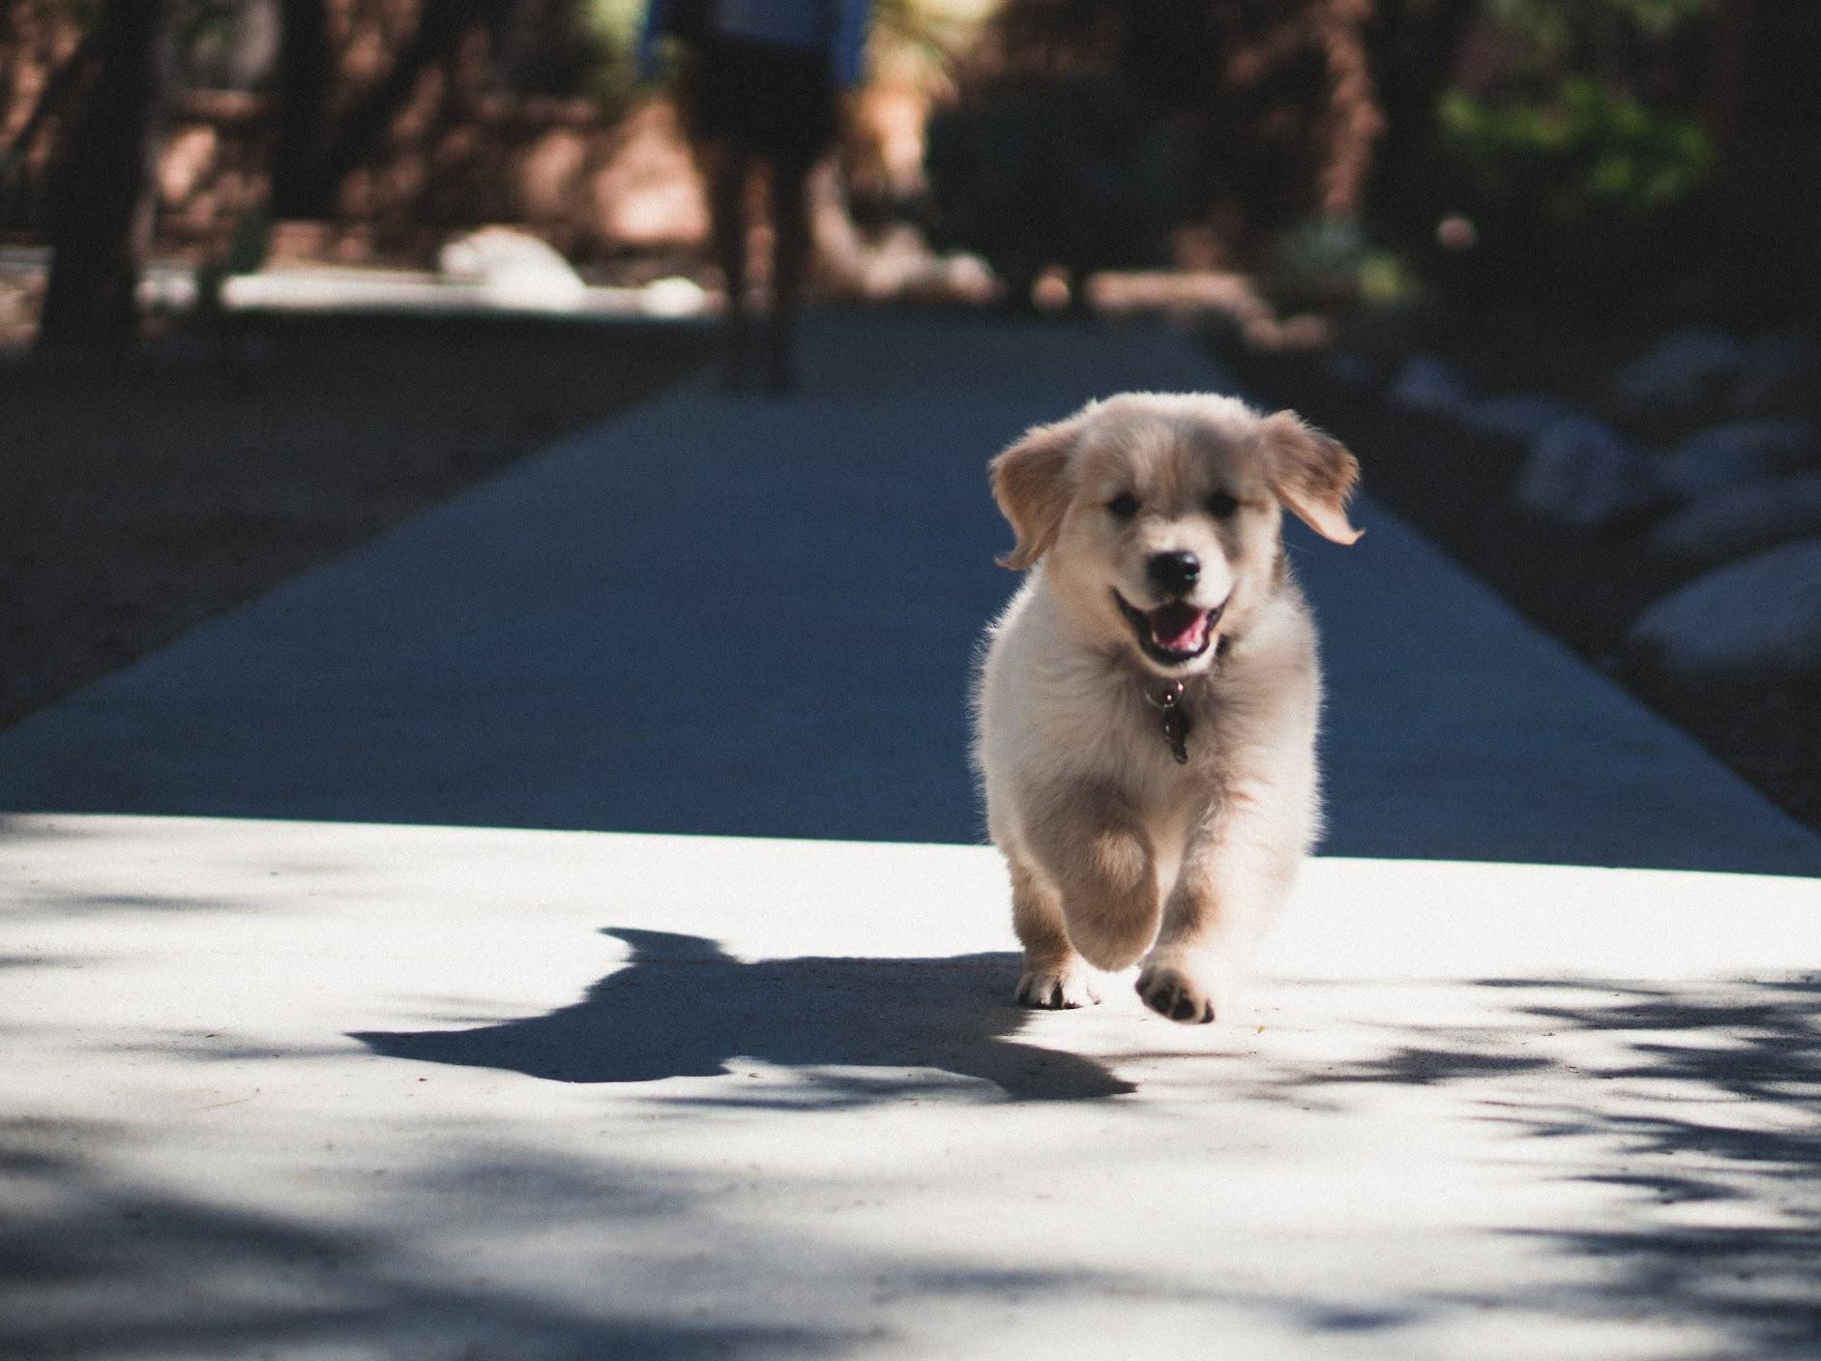
Our language reflected how love-drunk we’d gotten: the word “puppy” is thought to have been adapted from the French poupée, or doll—an object on which we lavish irrational affection.
Today, at least in areas populated by humans, dogs are the planet’s most abundant terrestrial carnivore. There are about 900 million of them worldwide, just shy of 80 million of whom live in the U.S. alone. The single species that is the domestic dog—Canis lupus familiaris—has been subdivided into hundreds of breeds, selected for size or temperament or color or cuteness.
Some humans love dogs
An example of a puppy running happily toward a human.
Notes:
Create your composition right on this slide. Or make a copy of the slide and try to create a few different versions for different types of audiences.
Text taken from: https://time.com/5342964/human-bond-dog-thoughts/

Slide 4
Nice work!
Now download the example solutions from the activity section.
GDPC | Activity

