Slide 1
Data Visualization Prompt
Consider how you would improve the provided charts.
GDPC | Activity

Slide 2
Chart 1
Rework the stacked bar chart on the next slide to better tell its story.
You can think through the changes you would make, or actually use the visual tools in PowerPoint to mock up a new design.
GDPC | Activity

Slide 3
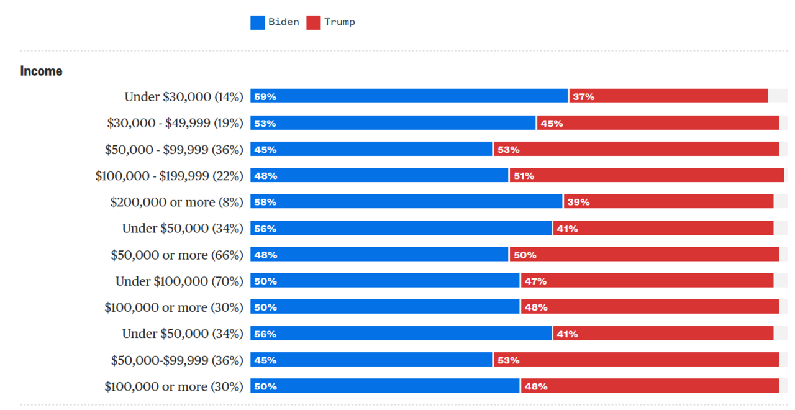
GDPC | Activity
Notes:
https://viz.wtf/

Slide 4
Create your version of Chart 1 here.
GDPC | Activity

Slide 5
Chart 2
How can you improve the visual design of this bar chart?
You can think through the changes you would make, or actually use the visual tools in PowerPoint to mock up a new design.
GDPC | Activity

Slide 6
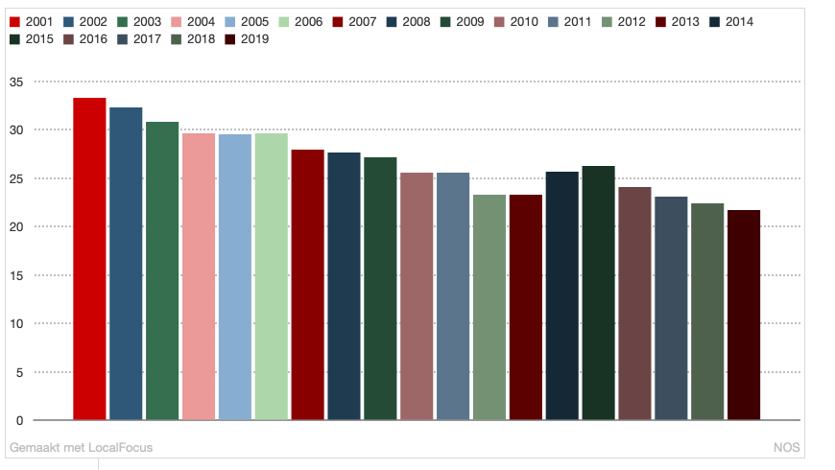
GDPC | Activity
Notes:
https://viz.wtf/

Slide 7
Create your version of Chart 2 here.
GDPC | Activity

Slide 8
Nice work!
Now download the example solutions from the activity section.
GDPC | Activity

