Slide 1
Data Visualization Solution
Solutions follow!
Download and try your hand at the activity PowerPoint before opening these slides.
GDPC | Activity

Slide 2
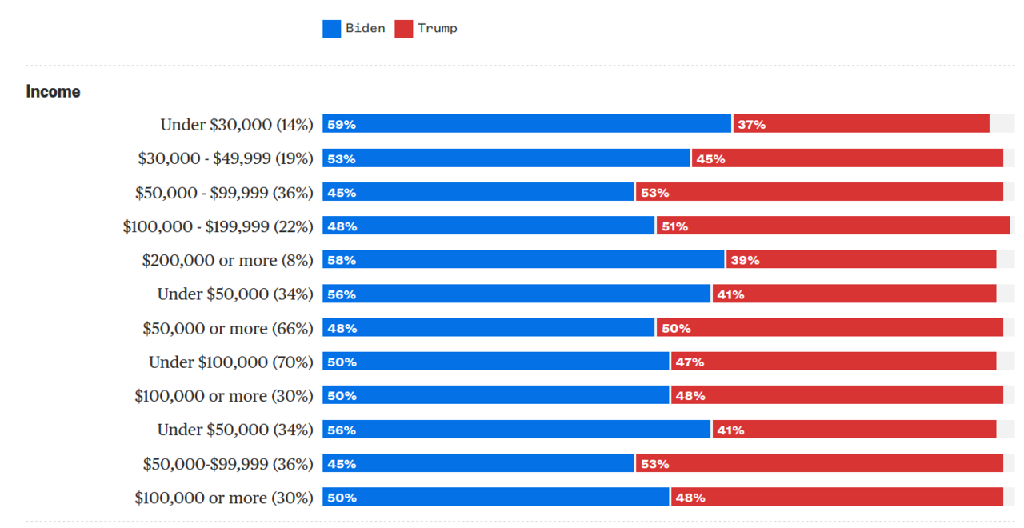
GDPC | Activity
Notes:
https://viz.wtf/

Slide 3
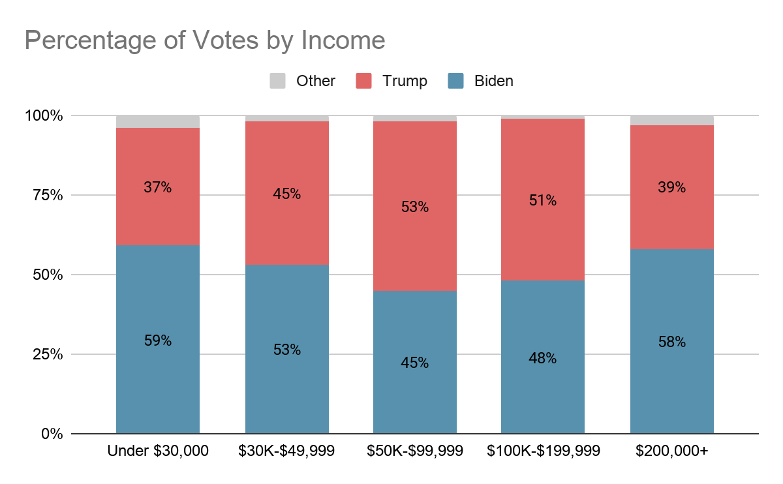
Chart 1 Reworked!
Key message is about the distribution of votes for the Republican vs. Democratic candidate per income level so simplify!
Consider the context of the story you’re telling which selecting the granularity of categories to display
GDPC | Activity
Notes:
https://viz.wtf/

Slide 4
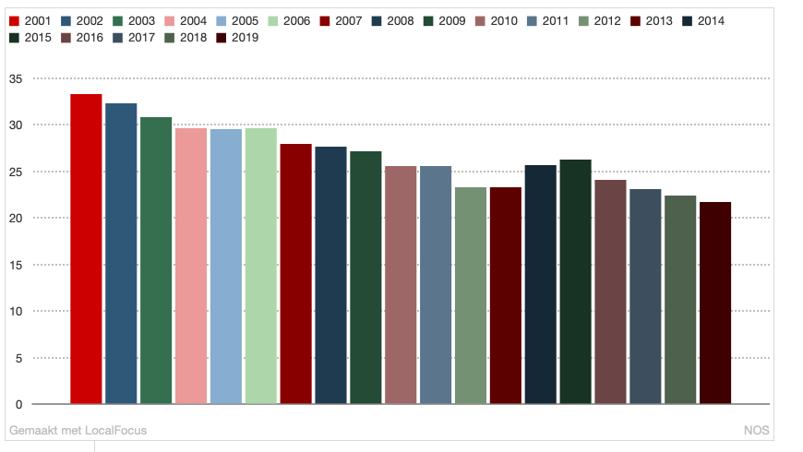
GDPC | Activity
Notes:
https://viz.wtf/

Slide 5
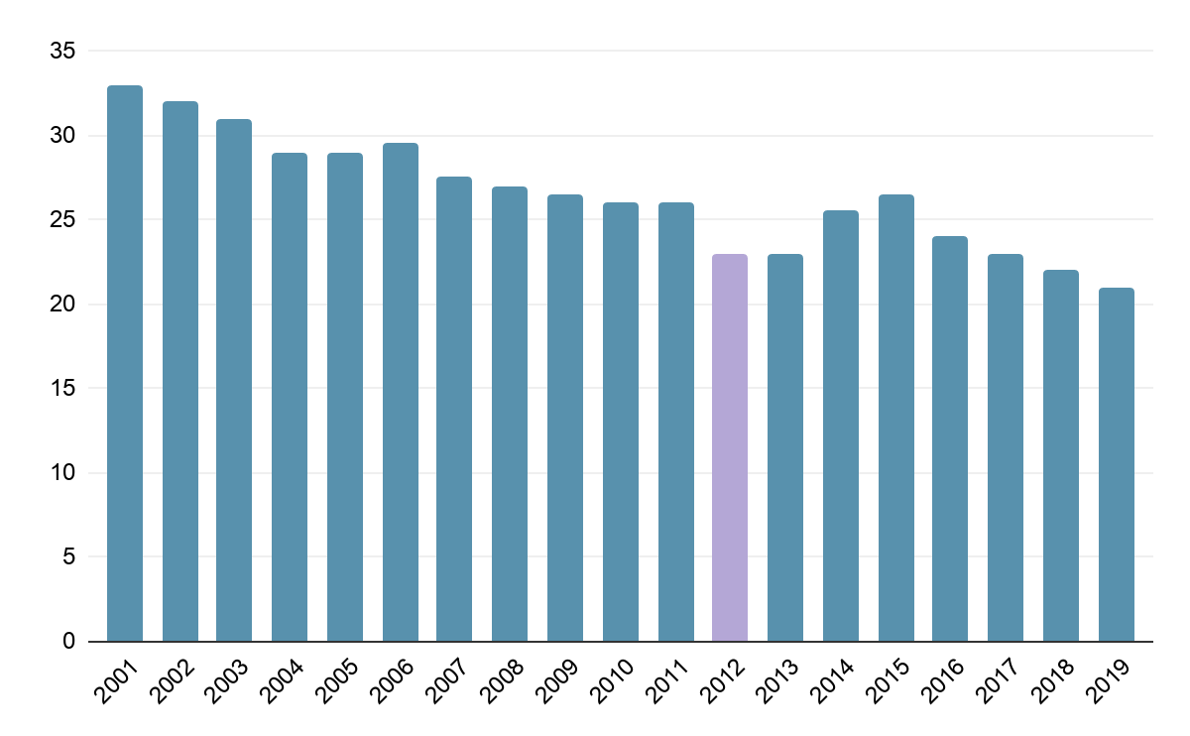
Don’t use color without purpose!
Use color to highlight a key data point
Don’t add a legend when it’s not needed, label the bars instead
GDPC | Activity
Notes:
https://viz.wtf/

