Slide 1
Icons Prompt
Find matching icons for the words “morning” and “evening”. Try a literal and a metaphorical pair.
Find icons at https://thenounproject.com.
GDPC | Activity

Slide 2
Icon Tips
Remember to go for consistency.
Don’t forget to think about the cultural meaning of symbols among your target audience.
You can search by author and similar icons on Noun Project.
GDPC | Activity

Slide 3
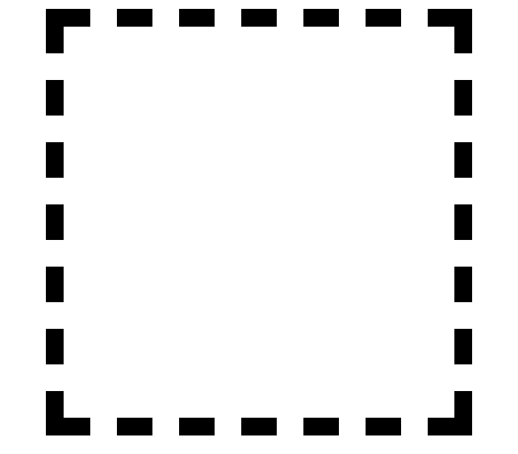
Insert Your Literal Icons Below
Morning Night
GDPC | Activity

Slide 4
Insert Your Metaphorical Icons Below
Morning Night
GDPC | Activity

Slide 5
Nice work!
Now download the example solutions from the activity section.
GDPC | Activity

