Slide 1
Icons Solution
Solutions follow!
Download and try your hand at the activity PowerPoint before opening these slides.
GDPC | Activity

Slide 2


Literal Icons
Morning Night
GDPC | Activity
Notes:
You can crop by shapes in Google Slides. The first sun was originally this: https://thenounproject.com/term/sun/3617908/

Slide 3

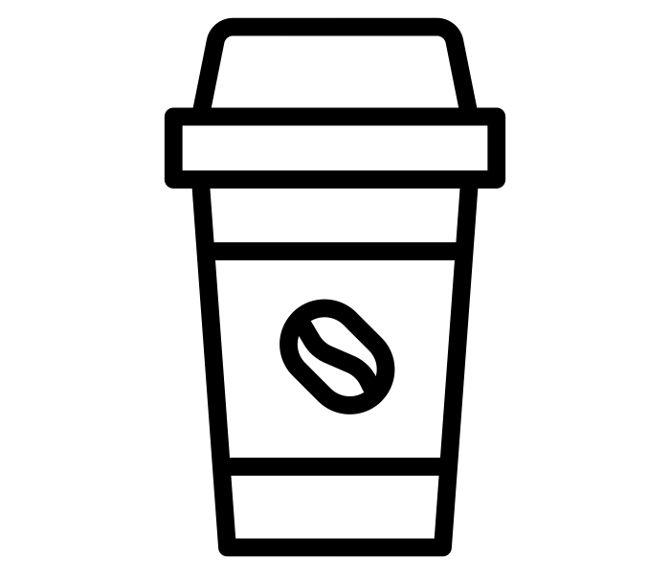
Metaphorical Icons
Morning Night
GDPC | Activity

