Slide 1
Strategy Prompt
Draw a line to match the audience to the appropriate strategy. Then choose the best presentation cover for each combo.
GDPC | Activity

Slide 2
Audience
West Hollywood Project Update (to Community)
Research Project Status Update (to NSF Client)
Dissertation Progress Update (to Committee)
Strategy
direct professionalism
casual friendliness
playfully informative
GDPC | Activity

Slide 3
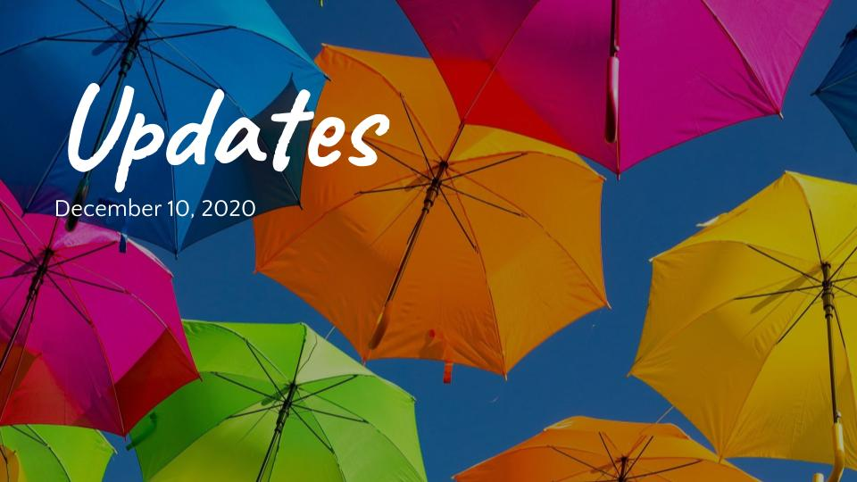
Audience
Strategy
GDPC | Activity

Slide 4

Audience
Strategy
GDPC | Activity

Slide 5
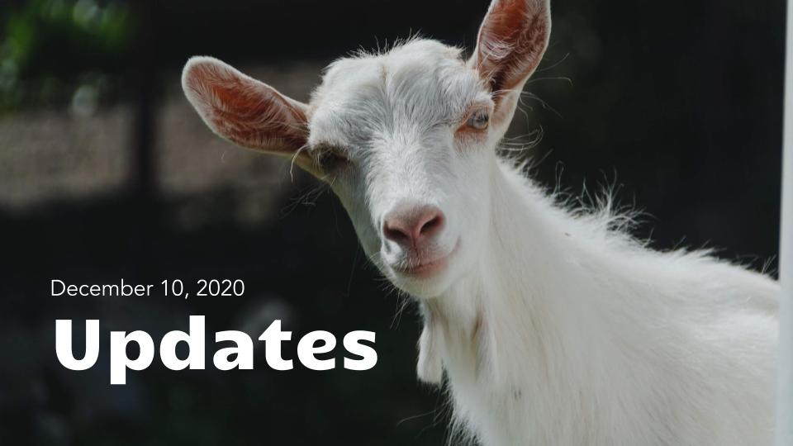
Audience
Strategy
GDPC | Activity

Slide 6
Nice work!
Now download the example solutions from the activity section.
GDPC | Activity

